Slide 1

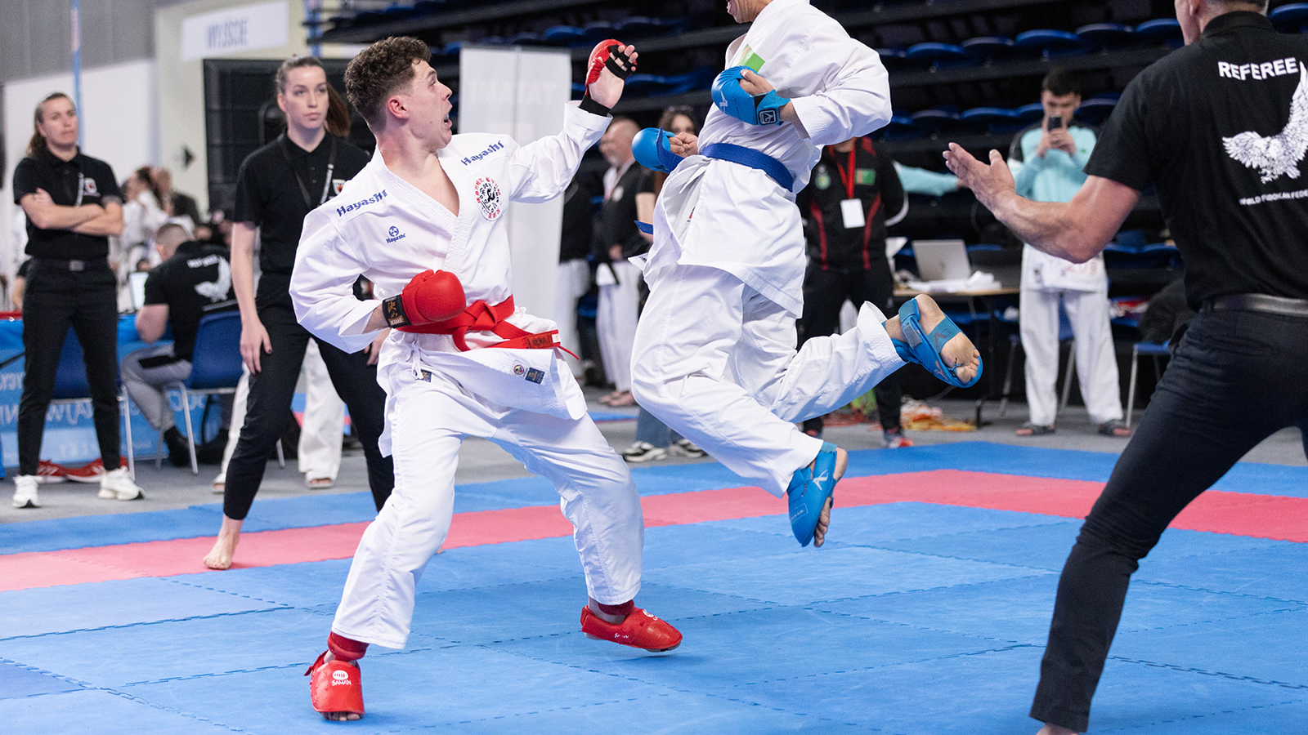
KUMITE AND KATA COMPETITION RULES
Sports Karate-do

Slide 2
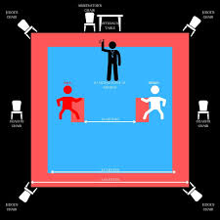
ARTICLE 1: KUMITE COMPETITION AREA
The competition area must be flat and devoid of hazard.
The competition area will be a matted square, of a WFF approved type, with sides of eight meters (measured from the outside) with an additional one meter on all sides as a safety area. There will be a clear safety area of two meters on each side.
Two mats are inverted with the red side turned up in a one meter distance from the mat center to form a boundary between the contestants.
The Refereeing Panel

Slide 3
Refereeing system with Referee and Judge
1. The Refereeing Panel for each match shall consist of one Referee (SHUSHIN), one Judge (FUKUSHIN), and one Kansa (KANSA) will be standing in front of them, centered between the two mats facing the Competitors at a distance of one meter from the safety area.
2. The Kansa will be seated just outside the safety area, behind, and to the left or right of the Central Referee (Sushin). He will be equipped with a whistle, a pen and a score paper, because he is the responsible of the score.
3. The Refereeing panel for each match shall consist of one Referee (Shushin) and two Judges, (Judge no. 1 and Judge no. 2) seated on opposite site in front Referee. Judges will have two flags ( one red and one white) for signalization.
4. Coaches will be seated outside the safety area, on their respective sides at the side of the tatami towards the official table. Where the tatami area is elevated, the coaches will be placed outside the elevated area.
5. The one-meter border should be in a different color from the rest of the matted area

Slide 4
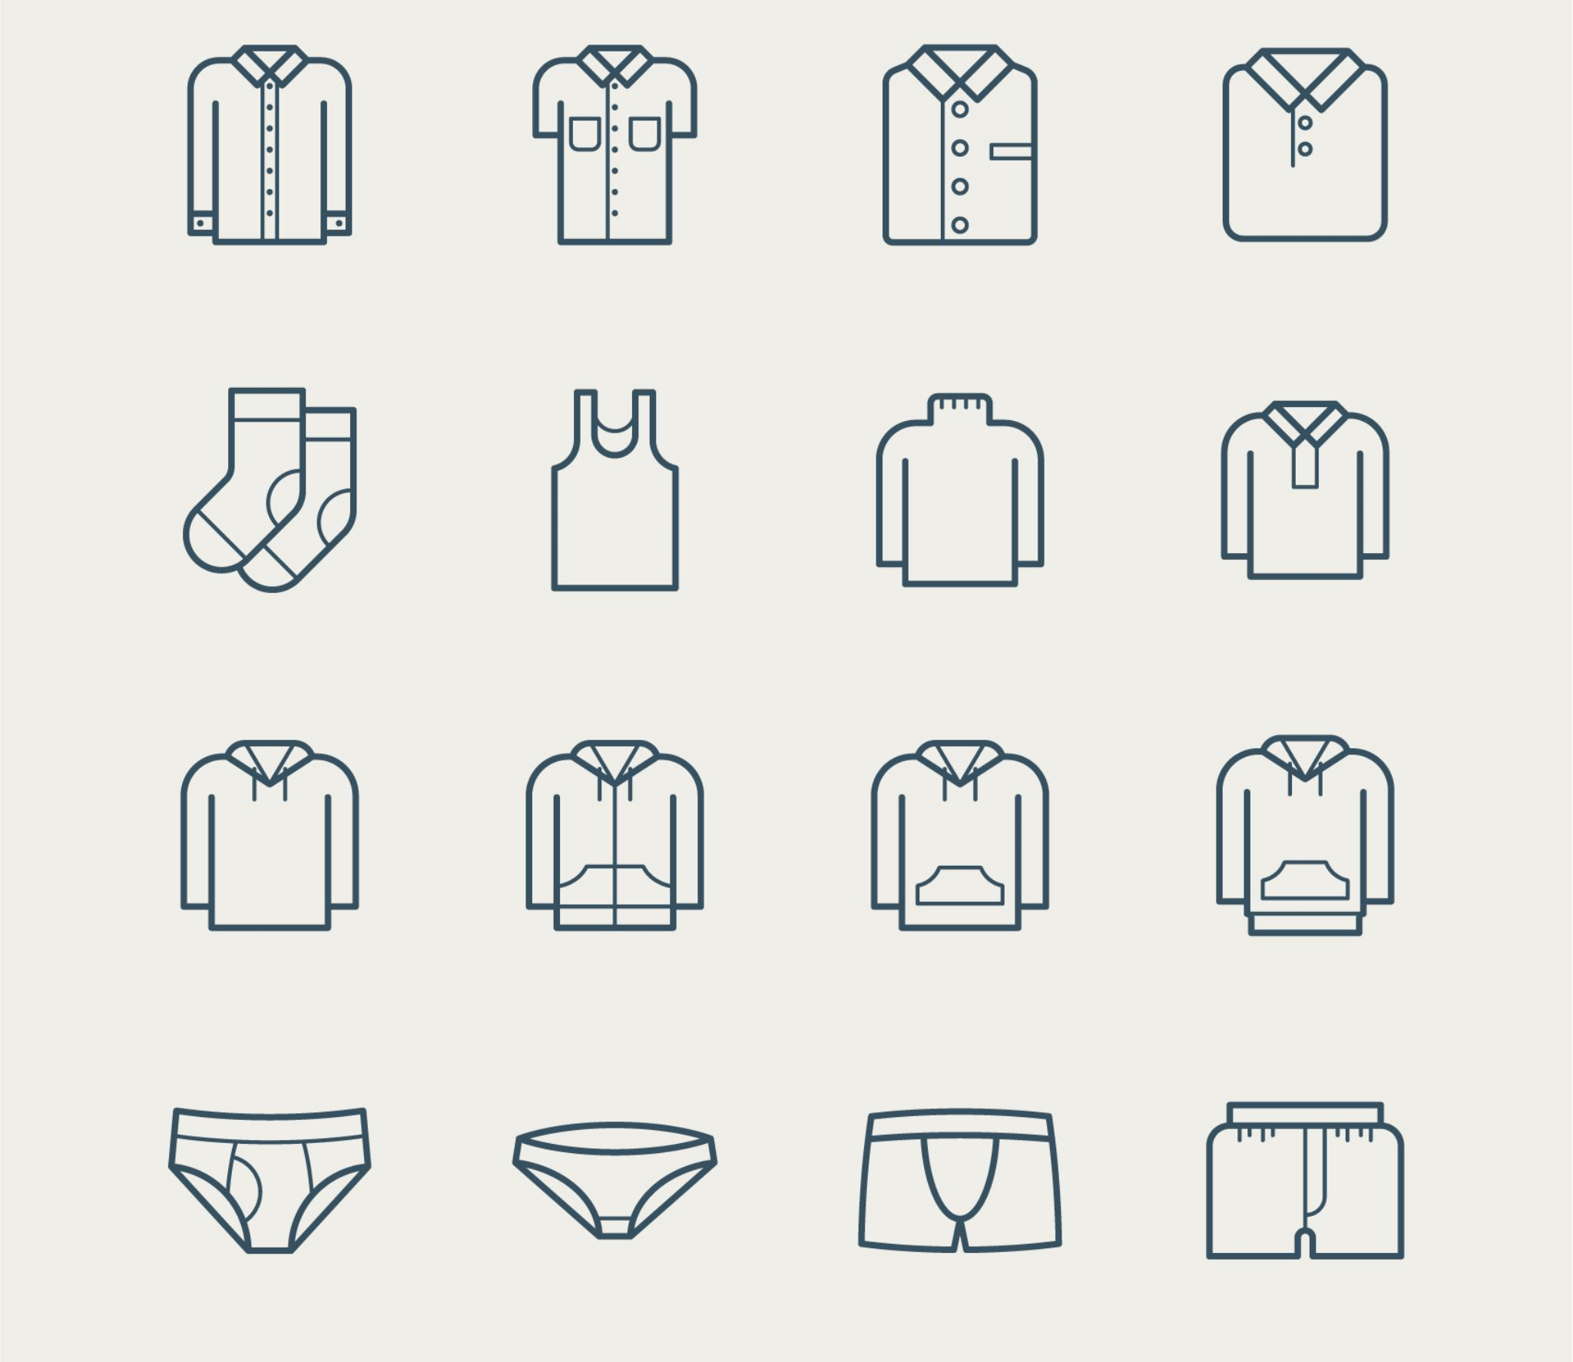
ARTICLE 2: OFFICIAL DRESS
1. Contestants and their coaches must wear the official uniform as here in defined.
2. The Referee Commission may disbar any official or competitor who does not comply with this regulation.
REFEREES
Referees and Judges must wear the official uniform designated by the Referee Commission. This uniform must be worn at all tournaments and courses. The official uniform will be as follows:
a. Grey pants
b. White Shirt with WFF red tie
c. Blue Navy Jacket ( optional ) and black shoes

Slide 5
CONTESTANTS – important ground rules
Contestants must wear a white karate gi without stripes, piping or personal embroidery.
Contestant must wear a belt. The belt is red for AKA and white for SHIRO. During the match is not possible wear their colored belts.
Contestants must have short fingernails and must not wear metallic or other objects, which might injure their opponents. The use of metallic teeth braces must be approved by the Referee and the Official Doctor. The contestant accepts full responsibility for any injury.

Slide 6

KUMITE CHILDRENS (NIHON)
1. Helmet;
2. Chest Protector;
3. Mitts; (Red and White)
4. Shin protector; (Red and White)
5. Foot protection; (Red and White)

Slide 7
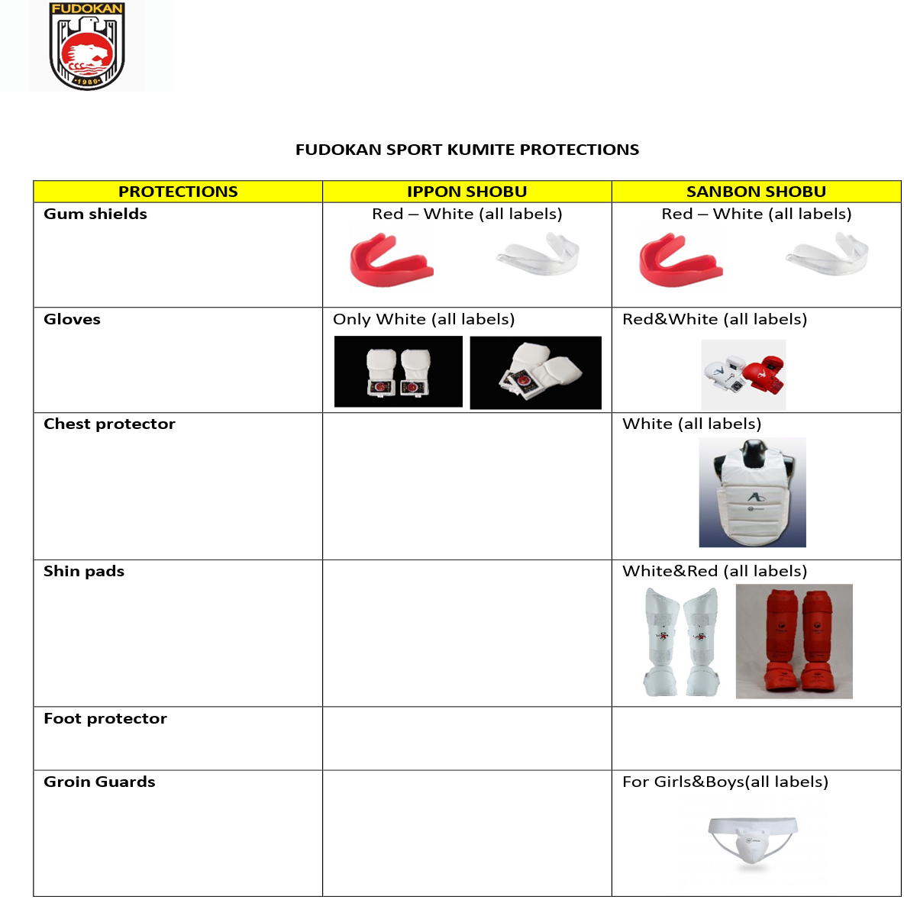
Kumite protections

Slide 8
KUMITE CHILDRENS (NIHON)
KUMITE FOR CHILDREN’S AGE
1. Techniques to all scoring areas (Jodan and Chudan) are all to be
controlled short of target.
2. Any full contact to the jodan area, in principle will be
penalized.
3. A correctly performed technique to any scoring area in principle will be considered a score at a distance up to 10cm.
4. Even controlled techniques to the body (chudan area) in principle will not be considered a score if they make contact beyond surface touch.
5. Sweeping, or other takedown techniques, are allowed.
6. The bout duration is one minute.
7. The fighting area may be reduced from 8x8 mts. to 6x6 mts. if desired by the organizer of the event.

Slide 9
KUMITE CHILDRENS (NIHON)
COACHES
Coaches shall at all times during the tournament, wear the official tracksuit of their National Federation and display their official identification.
Coaches must present their accreditation together with that of their competitor or team to the official table.
The coach must sit in the chair provided and must not interfere with the smooth running of the match by word or deed.

Slide 10
Individual Kumite
Male Kumite Shobu 8 to 9 Years (A) CHILDRENS All Styles / All Belts -35 Kg + 35 Kg | Male Kumite Shobu 10 to 11 Years (B) CHILDRENS All Styles / All Belts - 40 Kg + 40 Kg | Male Kumite Shobu 12 to 13 Years (C) JUVENIL All Styles / All Belts -45 Kg +45 Kg | Male Kumite Shobu 14 to 15 Years (D) CADETS All Styles / All Belts -60 Kg -65 Kg +65 Kg TEAMS
Female Kumite Shobu 8 to 9 Years (A) CHILDRENS All Styles / All Belts -35 Kg + 35 Kg | Female Kumite Shobu 10 to 11 Years (B) CHILDRENS All Styles / All Belts -40 Kg + 40 Kg | Female Kumite Shobu 12 to 13 Years (C) JUVENIL All Styles / All Belts -40 Kg +40 Kg | Female Kumite Shobu 14 to 15 Years (D) All Styles / All Belts -50 Kg -60 Kg +60 Kg TEAMS

Slide 11
INDIVIDUAL SHOBU IPPON KUMITE
Matches will be judged using the flag system.
Each match will have a duration of two (2) minutes of running time. The clock will only be stopped when the Referee calls “Time.”
CATEGORIES KUMITE INDIVIDUAL SHOBU IPPON
14 to 15 Years CADETS | Male: -50 kg / -58 kg / - 65 kg / + 65 kg Female: -48 kg / -55 kg / + 55 kg
16 to 17 Years JUNIORS | Male: -65 kg / -75 kg / - 80 kg / - 85 kg / + 85 kg Female: -60 kg / - 68 kg / - 75 kg/ - 82 kg /+ 82 kg
18 to 20 Years UNDER 21 | Male: -70 kg / - 80 kg / - 90 kg / + 90 kg Female: -65 kg / - 75 kg/ - 85 kg /+ 85 kg
21 to 35 Years SENIORS
36 to 50 Years MASTERS
+ 51 Years VETERANS

Slide 12
All belts / Height Categories
The match is won when a competitor scores 2 Waza-ari or one Ippon.
All points and penalties under Ippon Shobu from Fudokan rules shall apply to Shobu Ippon from Fudokan Sport with this exception: the awarding of Keikoku, Chui, Jogai penalties does not result in points add to the oponent. These penalties will only be taken into account in the event of a tie.
In HANTEI, Fukushin judge shall base the decision on the following criteria:
a) Number of Ippon scored
b) Number of Waza-ari scored
c) Any penalties (Keikoku, Chui, Jogai,)
In the event of a tie, the Central Referee shall call for Hantei, and the four judges shall cast their votes. If the tie persists after Hantei, a new match SAI SHIAI shall be conducted.
All scores and warnings from the previous match shall not be carried over into the Sai Shiai, as it is considered a new match.
The required equipment shall consist of: gum shields, gloves B, breast protection for women, and groin protection.

Slide 13
IPPON KUMITE — TEAM ROTATION FORMAT
Kumite Shobu Ippon – Team Rotation Categories Male & Female (All Belts/ Open weight)
14 to 15 Years CADETS
16 to 17 Years JUNIORS
18 to 20 Years UNDER 21
21 to 35 Years SENIORS
36 to 50 Years MASTERS
As a general rule, the provisions applicable to Individual Shobu Ippon apply also to Team Rotation. Matches will be judged using the flag system
Team Rotation Kumite match time is 4 minutes of continuous running time.
Each team shall consist of three competitors and one reserve. A team must have at least three competitors in order to participate.
Every competitor must fight at least once, for a minimum of 15 seconds during the prescribed match time of 4 minutes.
Each team may have one reserve competitor, who may only be used in the following round in case of injury.
When a new competitor enters the Tatami, both competitors must compete for at least 15 seconds before any further substitution can take place.
If, at the end of the match (after 4 minutes), any competitor has not fought, the team shall be disqualified (Hansoku).
If, during an action, one or two team members are scored with an Ippon, they shall be eliminated and may no longer participate in that match. The eliminated competitor(s) shall sit down near the Tatami. However, they may compete in a Sai Shiai if required.
If, at any point before the final signal, a competitor gains a lead of six (6) points the match will end immediately and that competitor’s team will be declared the winner, even if the other team members have not fought.
The first team to score 3 Waza-ari, or 2 Ippon shall be declared the winner.
At the end of the 4-minute match, the team with the highest total points shall be declared the winner. If the points are equal, the team with more Ippon shall be declared the winner.
If there is still no clear winner, the Referee shall call SOREMADE, followed by HANTEI. Based on the decisions of the corner judges, the Referee shall announce the outcome as Aka No Kachi, Shiro No Kachi, or Hikiwake. In the event of a Hikiwake, a Sai Shiai shall be held.
If, at the end of the Sai Shiai, there is still no clear winner, the Referee shall call HANTEI again. The judges must decide either Aka No Kachi or Shiro No Kachi.
In HANTEI, each judge shall base their decision on the following criteria:
a) Number of Ippon scored
b) Number of Waza-ari scored
c) Any penalties (Keikoku, Chui, Jogai, Tento)

Slide 14
SANBON KUMITE — TEAM ROTATION FORMAT
As a general rule, the provisions applicable to Individual Shobu Sanbon apply also to Team Rotation.
Matches will be judged using the flag system.
Team Rotation Kumite match time is:
3 minutes of continuous running time for Children and Juvenile divisions
5 minutes of continuous running time for Cadets, Juniors, Seniors, and Masters divisions
The clock will only be stopped when the Sushin calls “Time.” The Sushin will stop the match only in the event of an injury.
Kumite Shobu Sanbon – Team Rotation Categories Male & Female (All Belts/ Open weight)
10 to 11 Years (B) CHILDRENS
12 to 13 Years JUVENIL
14 to 15 Years CADETS
16 to 17 Years JUNIORS
18 to 20 Years UNDER 21
21 to 35 Years SENIORS
36 to 50 Years MASTERS
Each team must have three (3) competitors participating in every round. A team that cannot present three competitors at the start of a round will be declared withdrawn (Kiken) and will not be allowed to compete.
Each team may register one reserve competitor who can replace an injured athlete or be used at the coach’s discretion. This replacement will only take effect starting from the next round.
To ensure fair participation, every competitor must fight for a minimum of fifteen (15) seconds during the match time. If a competitor does not participate by the end of the match, the team will be disqualified (Hansoku).
If, at any point before the final signal, a competitor gains a lead of six (6) points in the Children and Juvenile divisions, or nine (9) points in the Cadets, Juniors, Seniors, and Masters divisions, the match will end immediately and that competitor’s team will be declared the winner, even if the other team members have not fought.

Slide 15
There is no maximum score limit; teams may accumulate points throughout the entire match duration.
When time expires, the team with the higher total score will be declared the winner.
If a six/nine-point lead is achieved within regulation time, the match will end immediately with that team declared the winner.
In the event of a tie at full time, the team with SENSHU will win.
A designated Change Judge will supervise substitutions and will be positioned outside the tatami opposite the Jury table, equipped with red and white flags.
The Change Judge’s responsibility is limited to indicating substitution timing and identifying the incoming competitor.
The Change Judge has no authority regarding scoring, penalties, warnings, or Hantei decisions.
During the match, the coach may request substitutions between the three competitors without limitation. Previously substituted competitors may re-enter later in the same round.
Substitution requests must be submitted before Atoshi Baraku and confirmed by the Change Judge.
The incoming competitor must be fully equipped and ready when called onto the tatami.
Substitution Procedure
Coaches must remain seated in designated chairs on either side of the Change Judge.
While one competitor is fighting, the remaining two must stay fully prepared to enter the tatami when called. At the start, Fighter 1 lines up at the mat edge, while Fighters 2 and 3 remain with the coach until their turn. After competing, a fighter must remain at the mat edge and not return to the coach’s position.
To initiate a substitution, the coach must clearly request “Change” to the Change Judge.
The Change Judge will verify the request and confirm that at least fifteen (15) seconds have elapsed since the previous substitution.

Slide 16
The Change Judge will signal the Referee using whistle, flag, and the verbal command “Change”.
Only the Referee may stop the match to authorize a substitution. The change must be completed within three (3) seconds; otherwise, the team will receive a penalty for delaying the match and the substitution will not be allowed.
Unauthorized substitutions will also result in a penalty.
A minimum of fifteen (15) seconds must pass before another substitution request may be made.
After a substitution, the opposing competitor must fight at least fifteen (15) seconds before being replaced.
Simultaneous substitutions by both teams are not permitted. The Change Judge must determine which request was made first.
Penalties
All warnings received by team members carry over within the same round and apply to substitute competitors.
If a competitor receives Hansoku, the entire team will be disqualified.
If a competitor receives Shikakku, the team will be removed from the tournament entirely.
Before imposing Shikakku, the Referee must consult with the Tatami Manager.

Slide 17
APPENDIX 8: WORLD / EUROPEAN
CHAMPIONSHIPS: CATEGORIES
5 JUNIOR | 6 UNDER 21 | 7 SENIORS | 8 MASTERS | 9 VETERANS
(16 -17 years) | (18 - 20 years) | (21 - 35 years) | (36 - 50 years) | (+ 51 years)
Male / Female | Male / Female | Male / Female | Male / Female | Male / Female
Individual Kata / Kata Team and Kata DUO All Style’s
Individual Kumite Shobu and Team
Male Kumite (age 16/17) | Male Kumite (age 18 - 20) | Male Kumite (age 21 - 35) | Male Kumite (age 36 - 50) | Male Kumite (age + 51)
-65 Kg. -75 Kg. +75 Kg. | -65 Kg. -75 Kg. +80 Kg. | -70 Kg. -80 Kg. +80 Kg. | -75 Kg. +75 Kg. | -OPEN.
Female Kumite (age 16/17) | Female Kumite ( age 18 – 20) | Female Kumite (age 21 - 35) | Female Kumite (age 36 - 50) | Female Kumite (age + 51)
-55 Kg. -65 Kg. +65 Kg. | -60 Kg. -65 Kg. +65 Kg | -60 Kg. -65 Kg. +65 Kg | -65 Kg. +65 Kg | -OPEN

Slide 18
ARTICLE 4: REFEREE PANEL
The Refereeing Panel for each match shall consist of one Referee (SHUSHIN), one Judge (FUKUSHIN), and one Arbitrator (KANSA), while in the case of 3-man
refereeing, it is made up of a Referee (SHUSHIN) and two Judges (FUKUSHIN).
In addition, for facilitating the operation of matches, several timekeepers, caller announcers, record keepers, and score supervisors shall be appointed.
EXPLANATION:
At the start of a Kumite match, the Referee, Judge and Kansa or Referee and Judges, in the case of arbitrage at 3, stands on the outside edge of the match area.
After the formal exchange of bows by contestants and the referee panel, the Referee takes a step back, the Judges and the Referee turn inwards, and all bow together. All then take up their positions.

Slide 19
ARTICLE 4: REFEREE PANEL
ARTICLE 5: DURATION OF BOUT
1. Duration of the Kumite bout varying because category as defined on below table. Fight ends when contestants point difference reaches 8 points or more (6 points or more for children’s categories).
2. Duration of the Kumite bout is defined:
DURATION OF BOUT
Masters Male Senior Male Under 21 Male | Veterans Masters Female Senior Female Under 21 Female Cadets and Juniors | Children’s ▪ or two ippon ▪ or three wazari ▪ or six yuko)
(both teams and individuals)
2 minutes | 1,30 minutes | 1 minutes

Slide 20
ARTICLE 6: SCORING
1. Scores are as follows:
A. IPPON - 3 points
B. WAZARI - 2 points
C. YUKO - 1 point
3. YUKO is awarded for:
I. Chudan or Jodan Tsuki,
II. Jodan or Chudan Uraken Uchi.
III. Chudan Mawashi Enpi Uchi.
3. WAZARI is awarded for:
I. Chudan kicks.
2. A score is awarded when a technique is performed according to the following criteria:
I. Good form
II. Sporting attitude
III. Vigorous application
IV. Awareness (ZANSHIN)
V. Good timing
VI. Correct distance, control , Kiai
4. IPPON is awarded for:
I. Jodan kicks.
II. Any scoring technique delivered on a thrown or fallen
opponent.
6. Attacks are limited to the following areas:
1) Head
2) Face
3) Neck
4) Abdomen
5) Chest
6) Back
7) Side

Slide 21
VOCABULARY | VOCABULARY TECHNICAL CRITERIA
Ippon (3 points) is awarded for: | Jodan kicks. Jodan being defined as the face, head and neck. Any scoring technique which is delivered on an opponent who has been thrown, has fallen of their own accord, or is otherwise off their feet.
Wazari (2 points) is awarded for: | Chudan kicks. Chudan being defined as the abdomen, chest, back and side.
Yuko (1 point) is awarded for: | 1. Any punch (Tsuki) delivered to any of the seven scoring areas. 2. Any strike (Uchi) delivered to any of the seven scoring areas.

Slide 22
ARTICLE 8: SCOREKEEPING
The Score Supervisor will use the following symbols for registration of points:
3 | IPPON | Tree point score
2 | WAZA ARI | Two point score
1 | YUKO | One point score
 | YOGAI 1 - CHUKOKU | Warning
 | HIKIWAKE | Draw
 | CHUKOKU (first instance) | 1st warning
 | KEIKOKU(second instance) | 2nd warning – One point
 | CHUI (third instance) | 3rd warning – Two points
 | HANSOKU | Disqualification from bout
 | SHIKKAKU Disqualification | Disqualification from tournament
 | YOGAI 2 - KEIKOKU YOGAI 3 – HANSOKU | One point WINNER
 | NO KACHI | WINNER

Slide 23
ARTICLE 9: PROHIBITED BEHAVIOUR
For better understanding, the following behaviors are prohibited:
1) Techniques which make excessive contact, having regard to the scoring area attacked and techniques which make contact with the throat.
2) Attacks to the arms or legs, groin, joints, or instep.
3) Attacks to the face with open hand techniques.
4) Techniques executed after “YAME” before “TSUZUKETE HAJIME” has been called.
5) Dangerous or forbidden throwing techniques.
6) Feigning, or exaggerating injury.
7) Exit from the competition area (JOGAI) not caused by the opponent or following a score.
8) Self-endangerment by indulging in behavior, which exposes the Competitor to injury by the opponent, or failing to take adequate measures for self-protection,(MUBOBI).
9) Avoiding combat as a means of preventing the opponent having the opportunity to score.
10) Passivity – not attempting to engage in combat (Cannot be given after there is less than 15 seconds left of the bout or to someone having a lead by point or SENSHU).
11) Clinching, wrestling, pushing, or standing chest to chest without attempting a scoring technique or takedown.
12) Grabbing the opponent with both hands for any other reasons than executing a takedown upon catching the opponents kicking leg.
13) Grabbing the opponent’s arm or Karate-gi with one hand without immediately attempting a scoring technique or takedown.
14) Techniques, which by their nature, cannot be controlled for the safety of the opponent and dangerous and uncontrolled attacks.
15) Simulated or actual attacks with the head, knees, or elbows.
16) Talking to, or goading the opponent, failing to obey the orders of the Referee, discourteous behavior towards the
Refereeing officials, or other violations of etiquette.

Slide 24
ARTICLE 10: POWERS & DUTIES
REFEREE COMMISSION
The Referee Commission’s powers and duties shall be as follows:
- To ensure the correct preparation for each given tournament in consultation with the Organizing Commission, with regard to competition area arrangement,the provision and deployment of all equipment and necessary facilities, match operation and supervision, safety precautions, etc.
- To appoint and deploy the Tatami Managers (Chief Referees) to their respective areas and to act upon and take such action as may be required by the reports of
the Tatami Managers.
- To supervise and co-ordinate the overall performance of the Refereeing officials.
- To nominate substitute officials where such are required.
- To pass the final Judgement on matters of a technical nature which may arise during a given match and for which there are no stipulations in the rules.
TATAMI MANAGERS
The Tatami Managers powers and duties shall be as follows:
1. To delegate, appoint, and supervise the Referees and Judges, for all matches in areas under their control.
2. To oversee the performance of the Referees and Judges in their areas, and to ensure that the Officials appointed are capable of the tasks allotted them.
3. To order the Referee to halt the match when the Match Supervisor signals a contravention of the Rules of Competition.
4. To prepare a daily, written report, on the performance of each official under their supervision, together with their recommendations, if any, to the Referee
Commission.

Slide 25
REFERES
The Referee's powers shall be as follows:
1. The Referee (“SHUSHIN”) shall have the power to conduct matches including announcing the start, the suspension, and the end of the match.
2. To award points based on the decision of the majority.
3. To stop the match when an injury, illness or inability of a contestant to continue is noticed.
4. To stop the match when it in the Referee’s opinion has been a point scored, a foul committed, or to ensure the safety of the contestants.
5. To stop the match when the judge has indicated a Jogai.
6. To indicate fouls observed (including Jogai), thus requesting the consent of the judge and kansa.
7. To request confirmation of the judge and kansa verdict in instances where there may, in the referee’s opinion, be grounds for the judges to re-evaluate their call for
warning or penalty.
8. To call the judge and kansa for conference (SHUGO) to recommend Shikkaku.
9. To explain to the Tatami Manager, Referee Commission, or Appeals Jury, if necessary, the basis for giving a Judgement.
10. To issue warnings and impose penalties based on the decision of the judge and kansa.
11. To announce and start an extra bout when required in team matches.
12. To conduct voting of the Judges, including his own vote, (HANTEI) and announce the result.
13. To resolve ties.
14. To announce the winner.
15. The authority of the Referee is not confined solely to the competition area but also to its entire immediate perimeter including controlling the conduct of coaches, other competitors, or any part of the competitors’ entourage, present on the competition floor.
16. The Referee shall give all commands and make all announcements.

Slide 26
JUDGES
The Judges (FUKUSHIN) powers shall be as follows:
i. To signal points scored and Jogai on their own initiative.
ii. To signal their judgement on warnings or penalties indicated by the Referee.
iii. To exercise their right to vote on any decision to be taken. The Judges shall carefully observe the actions of the contestants and signal to the Referee an opinion in the following cases:
i. When a score is observed.
ii. When a contestant has stepped out of the competition area (Jogai)
iii. Judgement on any other foul.
MATCH SUPERVISOR (REFEREEING WITH KANSA)
The Match Supervisor (KANSA) overseeing the match or bout in progress. Should decisions of the Referee and/or Judges, not be in accordance with the Rules of Competition, the Match Supervisor will immediately raise the red flag and blow his whistle. Will instruct the Referee to halt the match or bout and correct the irregularity.
2. Records kept of the match shall become official records subject to the approval of the Match Supervisor
3. Before the start of each match or bout the Match Supervisor will ensure that the contestants are wearing approved equipment.
4. Will keep a separate record of the scores awarded by the Referee and at the same time oversee the actions of the appointed timekeepers and scorekeepers

Slide 27
ARTICLE 11: STARTING, SUSPENDING & ENDING OF MATCHES
The Referee and Judges shall take up their prescribed positions and following an exchange of bows between the contestants whom are positioned at the center of their assigned mats; the Referee will announce “SHOBU HAJIME!” and the bout will start.
The Referee will stop the bout by announcing “YAME”. If necessary, the Referee will order the contestants to take up their original positions (MOTO NO ICHI).
When the Referee returns to his position, the Judge will indicate its opinion by means of a gesture. In the case of a score to be awarded the Referee identifies the contestant (AKA or SHIRO), the attacked area, (Chudan or Jodan) the attack technique (Tsuki, Uchi or Geri) and then awards the relevant score using the prescribed gesture. Referee then restarts the bout by calling “TSUZUKETE HAJIME”.
When a contestant has established a clear lead of eight points (six for Children) during a bout, the Referee shall call “YAME” and order the contestants back to their
starting points as he returns to his. The winner is then declared and indicated by the Referee raising a hand on the side of the winner and declaring “AKA SHIR NO
KACHI”. The bout is ended at this point.
When time is up, the contestant who has the most points is declared the winner, indicated by the Referee raising a hand on the side of the winner, and declaring
“AKA (SHIRO) NO KACHI”. The bout is ended at this point.
In the event of a tie, in the case of a team match, a 'HIKIWAKE' is declared, and the match ends. In case of individual competition, after 'HIKIWAKE', we proceed
directly with 'ENCHO SEN'. At the end of this, in the event of a further tie, the decision.
When the Referee considers that one or both contestants cannot continue with the bout owing to injuries, illness, or other causes. Heeding the tournament doctor's opinion, the Referee will decide whether the bout should be continued.

Slide 28
KATA RULES
ARTICLE 16: KATA COMPETITION AREA
1. The competition area must be flat and devoid of hazard.
2. The competition area must be of sufficient size to
permit the uninterrupted performance of Kata.
3. For kata competition the mats turned over to mark the
red area starting points for kumite contestants, are to be
turned back over to form a uniformed colored surface.
EXPLANATION:
For the proper performance of Kata, a stable smooth surface is required. Usually the matted Kumite areas will be suitable.
ARTICLE 17: OFFICIAL DRESS
1. Contestants and Judges must wear the official uniform as defined in Article 2 of the Kumite Rules.
2. Any person who does not comply with this regulation may be disbarred.
3. The karate-gi jacket may not be removed during the performance of Kata.
4. Contestants who present themselves incorrectly dressed will be given one minute in which to remedy matters

Slide 29
ARTICLE 18: KATA COMPETITION ORGANIZATION
1. Kata competition takes the form of Team and Individual matches. These competitions are in inter-style mode.
2. Team competitions are those that are held between different teams made up of three athletes each. Each team is composed exclusively by male or female athletes.
Individual competitions are held by single contestant,male or female.
3. Slight variations as taught by the contestant’s style of Karate will be permitted.
4. The score table will be notified of the choice of Kata prior to each round.
5. Contestants must change Kata in each round. Once performed a Kata may not be repeated. Exceptions are the withdrawal of the opponent which allows the reuse of the kata performed in the round and the final where one of the kata performed in the previous rounds can be resubmitted.
6. White, yellow, orange , green and blue belt athletes can repeat kata performed in previous rounds.
WORLD / EUROPEAN CHILDREN CHAMPIONSHIPS CATEGORIES
CHILDRENS
Individual Kata Until 7 Years (A) ▪ White to Blue | Individual Kata 8 to 9 Years (B) ▪ White to Blue | Individual Kata 10 to 11 Years (C) ▪ White to Blue | Individual Kata 12 to 13 Years (D) ▪ White to Blue
2 Kata minimum | 2 Kata minimum | 2 Kata minimum | 2 Kata minimum
EXPLANATION:
i. The number of Kata required is dependent on thenumber of individual competitors or teams entered asshown in the following table. Byes are counted ascompetitors or teams.

Slide 30
APPENDIX 8: WORLD / EUROPEAN
CHAMPIONSHIPS: CATEGORIES
WORLD / EUROPEAN CHILDREN CHAMPIONSHIPS CATEGORIES | CHILDRENS & CADETS
Individual Kata/kata DUO
1 CHILDRENS Until 7 Years | 2 CHILDRENS 8 to 9 Years | 2 CHILDRENS 10 to 11 | 4 JUVENIL 12 to 13 Years | 5 CADETS 14 to 15 Years
White to Orange Green to Blue | White to Orange Green to Blue Brown to Black | White to Orange Green to Blue Brown to Black | White to Orange Green to Blue Brown to Black | White to Orange Green to Blue Brown to Black TEAMS
Male Female | Male Female | Male Female | Male Female
The new category of kata duo allows performances of the same age category and in children's disciplines one age category and color grade deviation. Example 1: children 7 years old white belt, can compete with a child 8 years old yellow belt. Example 2: children 9 years old green belt, can compete with a child 8 years old blue belt, orange belt or with a child 10 years old blue or orange belt. The same belt grades are always allowed. If a child 12 years old black belt competes, an 11 year old brown belt can also compete with him.

Slide 31
Number of Competitors | Number of groups | Number of Kata performed to | Competitors in the second round
2 | 1 | 1 | Zero (no second round )
3 | 1 | 1 | Zero (no second round )
4 | 2 | 2 | Medal Baut
5 to 10 | 2 | 2 | Medal Baut
11 to 24 | 2 | 3 | 8 competitors
25 to 48 | 4 | 4 | 16 competitors
49 to 96 | 8 | 4 | 32 competitors
97 to 192 | 16 | 5 | 64 competitors
ARTICLE 19: THE JUDGING PANEL
1. The panel of five Judges for each match will be designated by the Tatami Manager.
2. The Judges of a Kata match must not have the nationality of either of the participants.
3. In addition, timekeepers, scorekeepers and caller/announcers will be appointed.
EXPLANATION:
i. The Chief Judge will sit in the center position facing the contestants and the other four Judges will be seated at the corners of the competition area.
ii. Each Judge will have a red and a blue flag or, if electronic scoreboards are being used, an input terminal.

Slide 32
Kata Duet Categories
 | MALE | FEMALE | MIX M/F | BELTS | KATA PERFORMANCE
U7 / U9 | X | X | X | ALL | HEIAN 1-5, TAJIDI SHODAN
U9 / JUVENIL | X | X | X | ALL | HEIAN 1-5, TAJIDI SHODAN
JUVENIL/ CADETS | X | X | X | ALL | ALL KATAS
JUNIORS/UNDER 21 | X | X | X | ALL | ALL KATAS
SENIORS / MASTERS | X | X | X | ALL | ALL KATAS
MASTER / VETERANS | X | X | X | ALL | ALL KATAS
U7 / VETERANS | X | X | X | ALL | HEIAN 1-5, TAJIDI SHODAN
U7 / MASTERS | X | X | X | ALL | HEIAN 1-5, TAJIDI SHODAN
U9 / VETERANS | X | X | X | ALL | HEIAN 1-5, TAJIDI SHODAN
U9 / MASTER | X | X | X | ALL | HEIAN 1-5, TAJIDI SHODAN
JUVENIL / VETERANS | X | X | X | ALL | ALL KATAS
JUVENIL / MASTERS | X | X | X | ALL | ALL KATAS
CADETS / VETERANS | X | X | X | ALL | ALL KATAS
CADETES / MASTER | X | X | X | ALL | ALL KATAS

Slide 33
Kata Duet Rules
2 pairs AKA and SHIRO perform
each performs a kata of their choice or according to the rules
kata duet is judged according to WFF sport rules synchronization and demandingness of kata performance are key to the performance
a pair can perform with the same kata until the final performance, in the final they must perform a different kata
AFTER THE PERFORMANCES OF BOTH PAIRS, THE JUDGES CALL THE AKA AND SHIRO COUPLES TO THE FIELD AND MAKE THEIR DECISION FOR AKA/SHIRO WITH FLAGS.

Slide 34
ARTICLE 20: CRITERIA FOR EVALUATION
Official kata list - Only kata from the official kata list may be performed:
1 | Anan
2 | Anan Dai
3 | Ananko
4 | Aoyagi
5 | Bassai
6 | Bassai Dai
7 | Bassai Sho
8 | Chatanyara Kusanku
9 | Chibana No Kushanku
10 | Chinte
11 | Chinto
12 | Empi
13 | Fukyugata Ichi
14 | Fukyugata Ni
15 | Gankaku
31 | Ishimine Bassai
32 | Itosu Rohai Shodan
33 | Itosu Rohai Nidan
34 | Itosu Rohai Sandan
35 | Jiin
36 | Jion
37 | Jitte
38 | Juroku
39 | Kanchin
40 | Kanku Dai
41 | Kanku Sho
42 | Kanshu
43 | Kishimoto No Kushanku
44 | Kousoukun
60 | Nijushiho
61 | Nipaipo
62 | Niseishi
63 | Ohan
64 | Ohan Dai
65 | Oyadomari No Passai
66 | Pachu
67 | Paiku
68 | Papuren
69 | Passai
70 | Pinan Shodan
71 | Pinan Nidan
72 | Pinan Sandan
73 | Pinan Yondan
74 | Pinan Godan
90 | Shisochin
91 | Sochin
92 | Suparinpei
93 | Tekki Shodan
94 | Tekki Nidan
95 | Tekki Sandan
96 | Tensho
97 | Tomari Bassai
98 | Unshu
99 | Unsu
100 | Useishi
101 | Wankan
102 | Wanshu
103 | Heian Oi Kumi
104 | Tekki Oi Kumi
118 | Tensho
119 | Taiji Shodan
120 | Taiji Nidan
16 | Garyu
17 | Gekisai (Geksai) 1
18 | Gekisai (Geksai) 2
19 | Gojushiho
20 | Gojushiho Dai
21 | Gojushiho Sho
22 | Hakusho
23 | Hangetsu
24 | Haufa (Haffa)
25 | Heian Shodan
26 | Heian Nidan
27 | Heian Sandan
28 | Heian Youdan
29 | Heian Godan
30 | Heiku
45 | Kousoukun Dai
46 | Kousoukun Sho
47 | Kururunfa
48 | Kusanku
49 | Kyan No Chinto
50 | Kyan No Wanshu
51 | Matsukaze
52 | Matsumura Bassai
53 | Matsumura Rohai
54 | Meikyo
55 | Myojo
56 | Naifanchin Shodan
57 | Naifanchin Nidan
58 | Naifanchin Sandan
59 | Naihanchin
75 | Rohai
76 | Saifa
77 | Sanchin
78 | Sansai
79 | Sanseiro
80 | Sanseru
81 | Seichin
82 | Seienchin (Seiyunchin)
83 | Seipai
84 | Seiryu
85 | Seishan
86 | Seisan (Sesan)
87 | Shiho Kousoukun
88 | Shinpa
89 | Shinsei
105 | Kanku Oi Kumi
106 | Bassai Oi Kuni
107 | Kittei
108 | Kittei Nidan Higashiyama
109 | Pinan Shoden Gichin Fun.
110 | Setsu Bama Yama
111 | Washi No Maai
112 | Yon Rei
113 | Kaminari
114 | Tori Tobi
115 | Meikyo Shodan
116 | Meikyo Nidan
117 | Meikyo Sandan

Slide 35
Kata Performance
Conformance - To the form itself and the standards of the applicable style (Ryu-ha).
Technical performance
▪ Stances
▪ Techniques
▪ Transitional movements
▪ Timing/Synchronization
▪ Correct breathing
▪ Focus (kime)
▪ Technical difficulty
Athletic performance
▪ Strength
▪ Speed
▪ Balance
▪ Rhythm

Slide 36
Disqualification
A competitor or a team of competitors may be disqualified for any of the following reasons:
Performing the wrong kata or announcing the wrong kata. Perform a kata other than the one declared at the Jury table or announce a kata other than the one declared at the Jury table. When the athlete pronounces the name of the kata, the referee, in the event of a discrepancy with what the athlete declared at the Jury table, must repeat the name of the kata to be performed. If the announced kata is still different what was declared at the table.
Failing to bow at the beginning/ ending and completion of the kata performance. ii. A distinct pause or stop in the performance. iii. Interference with the function of the judges (such as the judge having to move for safety reasons or making physical contact with a judge). iv. Belt falling off during the performance. v. Failure to follow the instructions of the Chief Judge or other misconduct.
Fouls
The following fouls, if apparent, must be considered in the evaluation according to above criteria:
i. Minor loss of balance.
ii. Performing a movement in an incorrect or incomplete manner such as failure to fully execute a block or punching off target.
iii. Asynchronous movement, such as delivering a technique before the body transition is completed, or in the case of team kata; failing to do a movement in unison.
iv. Use of audible cues (from any other person, including other team members) or theatrics such as stamping the feet, slapping the chest, arms, or karate-gi, or inappropriate exhalation, will automatically be penalized by the judges deducting the total portion of the score for the technical performance of the kata (and thus losing one third of the total score for the performance)
v. Belt coming loose to the extent that it is coming off the hips during the performance.
vi. Time wasting, including prolonged marching, excessive bowing or prolonged pause before starting the performance.
vii. Distracting Judges by moving around while the opponent is performing

Slide 37
EXPLANATION:
iii. Kata is not a dance or theatrical performance. It must adhere to the traditional values and principles. It must be realistic in fighting terms and display concentration, power, and potential impact in its techniques. It must demonstrate strength, power, and speed — as well as grace, rhythm, and balance.
iv. Team members must start the Kata facing in the same direction and towards the Chief Judge.
v. The members must demonstrate competence in allaspects of the Kata performance, as well as synchronization.
vi. Signals to initiate and stop the execution of the kata, to stomp, to tap the chest, arms or Karategi, as well as to sigh, are examples of external signals and the Judges must take them into account when evaluating.

Slide 38
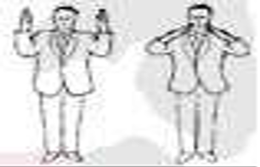
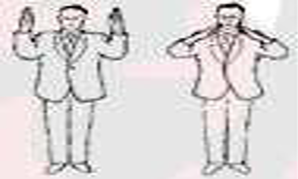
APPENDIX 2:
REFEREE AND JUDGES GESTURES, SIGNALS AND ANNOUNCEMENTS
GESTURES AND SIGNALS / ANNOUNCEMENTS AND GESTURES OF THE REFEREE
SHOMEN-NI-REI The Referee extends his arms palms to the front.
OTAGAI-NI-REI The Referee motions to the contestants to bow to each other

Slide 39

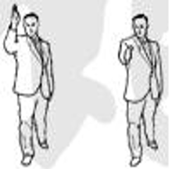
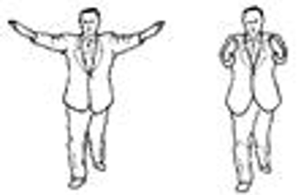
SHOBU HAJIME “Start the Match” After the announcement, the Referee takes a step back
YAME “Stop” Interruption or end of a match or bout. As he makes the announcement, the Referee makes a downward chopping motion with his hand.
TSUZUKETE HAJIME “Resume fighting—Begin” As he says “Tsuzukete”, and standing in a forward stance, the Referee extends his arms outward with his palms facing the contestants. As he says “Hajime” he turns the palms and brings them rapidly towards one another at the same time stepping back.

Slide 40
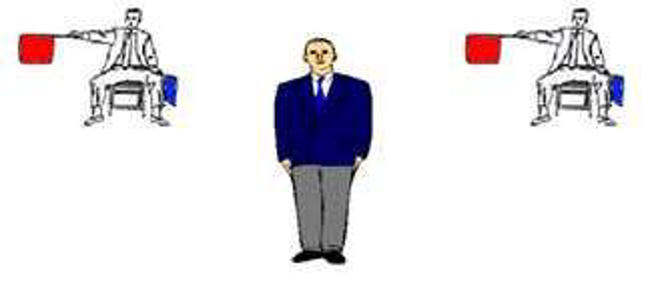
KUMITE WITH 3 REFEREES
Referee team

Slide 41
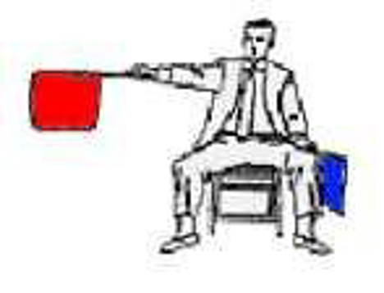

When two judges give the same signal orindicate the same score for a competitor, the referee must stop the match and apply the majority decision. When a judge signals a penalty or indicates a score for a competitor, the referee must take his opinion into consideration, but may refrain from interrupting the match if he believes that he is in error. In any case, when the meeting is stopped the majority decision will prevail. The referee can ask the judges to reconsider their decision, but cannot make a decision opposite to that of the two judges. The referee may ask the judges to review their decision if he believes that they were wrong or when compliance would represent a violation of the rules, for example when a technique was performed with excessive contact, when a score is awarded to a competitor who was outside the competition area (jogai). When the two judges have different opinions the referee can make a decision which is supported by one of the judges.
Judges must only report what they actually see. If they are not sure whether a technique has reached the scoring area, they do not have to signal. In the event that the referee does not hear the time-out bell the scoring supervisor will blow his whistle. In Hantei the referee and judges have one vote each.

Slide 42
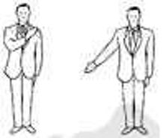

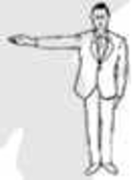
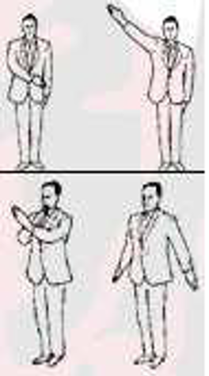
YUKO (One point) The Referee extends his arm downward at 45 degrees on the side of the scorer.
WAZA-ARI (Two Points) The Referee extends his arm at shoulder level on the side of the scorer.
IPPON (Three Points) The Referee extends his arm upward at 45 degrees on the side of the scorer.
CANCEL LAST DECISION When an award or penalty has been given in error the Referee turns towards the contestant, announces “AKA” or “AO”, crosses his arms, then makes a cutting motion, palms downward, to indicate that the last decision has been cancelled.

Slide 43
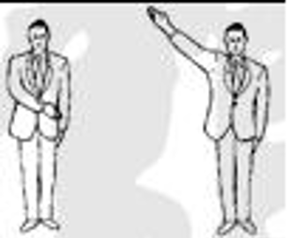
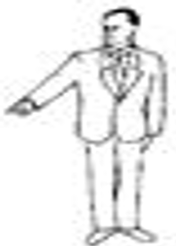
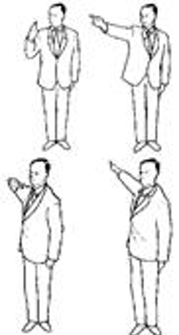
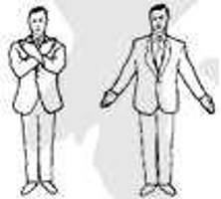
NO KACHI (Win) At the end of the match or bout, announcing “AKA (or AO) No Kachi” the Referee extends his arm upward at 45 degrees on the side of the winner.
KIKEN “Renunciation” The Referee points with the index finger towards the renouncing contestant's line then announces a win to the opponent.
SHIKKAKU “Disqualification, Leave the Area”. The Referee points first upwards at 45 degrees in the direction of the offender then motions out and behind with the announcement “AKA (AO) SHIKKAKU!” He then announces a win for the opponent
HIKIWAKE “Draw” (Only applicable to team matches). When time is up and scores are equal, or no scores have been awarded. The Referee crosses his arms then extends them with the palms showing to the front.

Slide 44
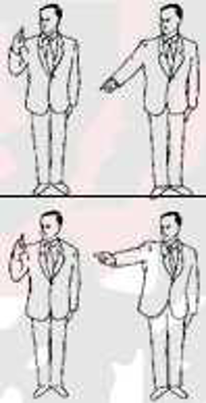
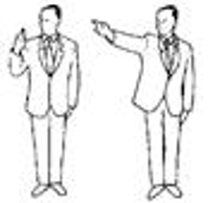

CHUI Referee points with One finger upwards at 45 degrees in the direction of the offender and give the warning
KEIKOKU “Warning”. The Referee indicates an offence then points with his index finger downwards at 45 degrees in the direction of the offender.
HANSOKU CHUI “Warning of disqualification”. The Referee indicates an offence then points with his index finger horizontally in the direction of the offender.
HANSOKU “Disqualification” The Referee indicates an offence then points with his index finger upwards at 45 degrees in the direction of the offender, and awards a win to the opponent

Slide 45
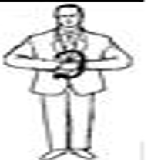
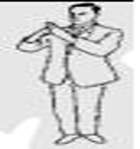
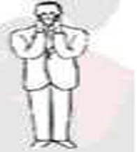
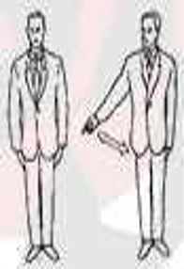
PASSIVITY The Referee rotates his fist around each other in front of his chest to indicate a offence.
EXCESSIVE CONTACT The Referee indicates to the Judges that there has been excessive contact or other offence.
FEIGNING OR EXAGGERATING INJURY The Referee holds both hands to his face to indicate to the Judges an offence
JOGAI “Exit from the Match Area” The Referee indicates an exit to the Judges, by pointing with the index finger to the match area boundary on the side of the offender.

Slide 46
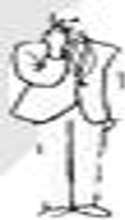
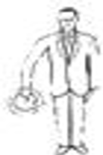
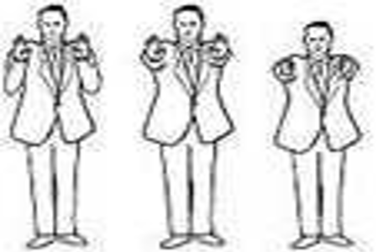

MUBOBI (Self Endangerment) The Referee touches his face then turning the hand edge forward, moves it back and forth to indicate to the Judges that the contestant has endangered himself.
AVOIDING COMBAT The Referee makes a circling motion with the down turned index finger to indicate to the Judges offence.
PUSHING, GRABBING OR STANDING CHEST TO CHEST WITHOUT ATTEMPTING AN IMMEDIATE TECHNIQUE OR TAKEDOWN The Referee holds both clenched fists at shoulder level or makes a pushing motion with both open hands to indicate to the Judges offence.
DANGEROUS AND UNCONTROLLED ATTACKS The Referee brings his clenched fist past the side of his head to indicate to the Judges offence.

Slide 47
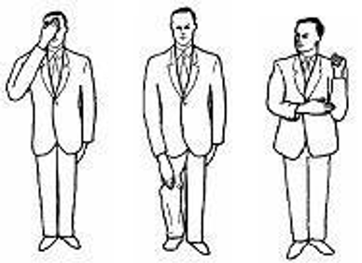
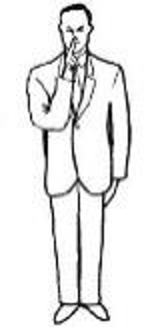
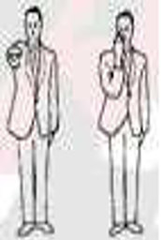
SIMULATED ATTACKS WITH THE HEAD KNEES OR ELBOWS The Referee touches his forehead, knee, or elbow with the open hand to indicate to the Judges an offence.
TALKING TO OR GOADING THE OPPONENT AND DISCOURTEOUS BEHAVIOUR The Referee places his index finger to his lips to indicate to the Judges an offence.
SHUGO “Judges Called” The Referee calls the Judges at the end of the match or bout or to recommend SHIKKAKU.

Slide 48
APPENDIX 3: OPERATIONAL GUIDELINES FOR REFEREES AND JUDGES
EXCESSIVE CONTACT
EXCESSIVE CONTACT AND EXAGGERATION
1. When a contestant makes a scoring technique immediately
followed by another which makes excessive contact the Judges
do not award the score and instead issues a warning or penalty
(unless it is the recipient’s own fault).
Karate is a Martial Art and a high standard of behavior is
expected from competitors. It is unacceptable that competitors,
who receive a light contact, rub their faces, walk or stagger
around, bend over, pull or spit out their gum-shields, and
otherwise pretend that the contact is severe in order to
convince the Referee to give a higher penalty to the opponent.
This kind of behavior is cheating and demeans our sport; it
should be quickly penalized.

Slide 49
2. When a competitor makes pretense of having received an
excessive contact and the Judges decide instead that the
technique in question was controlled, satisfying all six scoring
criteria, then a score will be awarded and a penalty for feigning
will be issued. The correct penalty for feigning an injury when
the Judges have determined that the technique in fact was a
score is Shikkaku.
5. Should the offender receive an excessive contact and/or sustain
an injury the Referee will issue a warning or penalty and decline
to give a warning or penalty to the opponent.
6. A contestant who is hit through their own fault and
exaggerates the effect in order to mislead the Judges may
receive a warning or penalty for Mubobi as well as an
additional penalty for exaggeration, since two offences have
been committed.
3. More difficult situations occur when a competitor receives a
stronger contact and falls to the floor, sometimes standing up
(in order to stop the 10 second clock) and then falling down
again. The Referees and Judges must remember that a Jodan
kick is worth 3 points and as the number of teams and
individual competitors receiving financial reward for winning
medals increases the temptation to stoop to unethical
behavior becomes stronger. It is important to recognize this
and apply the appropriate warnings or penalties. MUBOBI
7. It should be noted that there are no circumstances in which
a technique that has made excessive contact can be given a
score.
4. A warning or penalty for Mubobi is given when a competitor is
hit or injured through his or her own fault or negligence.
This may be caused by turning their back on the opponent,
attacking with a long, low Gyaku Tsuki chudan without regard
for the opponent’s Jodan counter attack, stopping fighting
before the Referee calls “Yame”, dropping their guard or
concentration and repeated failure or refusal to block the
opponent’s attacks.
ZANSHIN
8. Zanshin is described as a state of continued commitment in
which the contestant maintains total concentration,
observation, and awareness of the opponent's potentiality to
counter- attack. Some contestants after delivering a
technique will turn their body partially away from the
opponent but are still watching and ready to continue the
action. The Judges must be able to distinguish between this
continued state of readiness and one where the contestant
has turned away, dropped their guard and concentration, and
in effect has ceased fighting.

Slide 50
CATCHING A CHUDAN KICK
9. Should the Judges award a score when a contestant delivers
a chudan kick and the opponent then catches the leg before
it can be withdrawn?
THROWING AND INJURIES
11. Since grabbing hold of the opponent and throwing is allowed
under certain conditions it is incumbent upon all coaches to
ensure that their competitors are trained in and are able to use
break-fall/safe landing techniques.
10. Provided that the kicking contestant maintains ZANSHIN there is
no reason why this technique cannot score provided that it
contains all six of the scoring criteria. Theoretically, in a real fight
scenario, a full power kick would be deemed to have
disabled the opponent and therefore the leg would not be
grabbed. Appropriate control, the target area, and
satisfaction of all six criteria, are the deciding factors as to
whether any technique can be awarded a score or not.
A potentially dangerous situation occurs when a contestant
grabs both legs to throw the opponent onto their back or
when a contestant ducks down and bodily lifts the opponent up
before throwing him. The Article 8, Explanations XI states
that “…and the opponent must be held onto throughout, so
that a safe landing can be made.” Since it is difficult to ensure a
safe landing, throws such as this fall into the prohibited
category.
SCORING ON A FALLEN OPPONENT
13. When a contestant is thrown or swept off their feet and is
scored upon when their torso (upper body or trunk) is on the
tatami then the score will be IPPON.
14. Should the contestant be hit by a technique whilst still actually
falling the Judges will take into account the direction of falling
since if the contestant is falling away from the technique it
will be considered ineffective and will not be scored.
15. Should the contestant’s upper body not be on the tatami
when an effective, scoring technique is made, then the points
awarded will be as stated. Therefore, the point(s) awarded when
a contestant is scored upon in the act of falling, sitting,
kneeling, standing, or jumping in the air, and all situations
where their torso is not on the tatami will be as follows:
i. Jodan Kicks, three points (IPPON)
ii. Chudan Kicks, two points (WAZA-ARI)
iii. Tsuki and Uchi, one point (YUKO)

Slide 51
